Slide 1

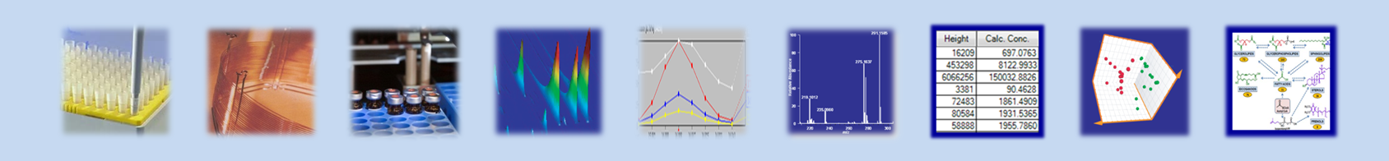


Pitfalls in Large-Scale Metabolomic Study of Human Plasma
Tomáš Čajka, Ph.D.
Metabolomics Seminar
December 4, 2013

Slide 2
NIH: P20 PROJECT
Metabolic pathways associated with atherosclerosis and cardiovascular risk factor
(RFA-HL-12-009 Anchoring Metabolomic Changes to Phenotype)
04/01/2012—03/31/2017
Introduction

Slide 3
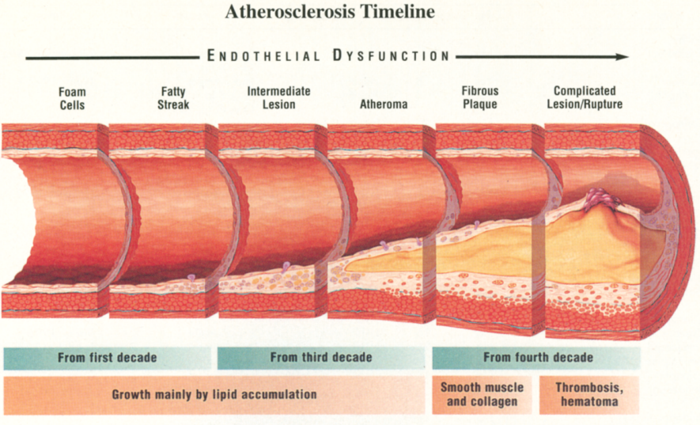
ATHEROSCLEROSIS
Myocardial infarction, stroke, and heart failure  the leading causes of death in the US
The disease primarily responsible for these major adverse cardiovascular events is atherosclerosis
A gradual thickening of the artery wall due to the accumulation of cholesterol and triglycerides
Introduction
Pepine CJ., Am J Cardiol 1998:82 Suppl 10A, 23S–27S

Slide 4
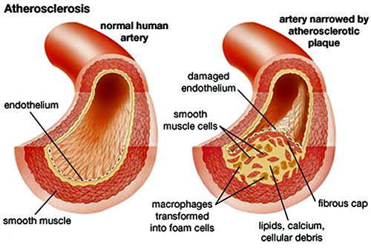
ATHEROSCLEROSIS
Atherosclerosis is an inflammatory response that results in hard plaques composed of three layers:
The artheroma (soft, flaky portion composed of macrophage white blood cells and lipids)
Underlying layers of cholesterol crystals
An outer calcified layer in advanced lesions
Introduction

Slide 5
ATHEROSCLEROSIS
A piece of “black” statistics
For 66% of men and 47% of women, the first sign of atherosclerosis is myocardial infarction (heart attack) that occurs when the atherosclerotic lesion breaks free of the artery wall and blocks blood flow.
Most cases of myocardial infarction occur when an atherosclerotic lesion causes less than 50% occlusion of the artery, yet we are currently unable to detect plaques smaller than 75% occlusion
Introduction
Nissen SE, Nicholls SJ, Sipahi I, et al. (2006). “Effect of very high-intensity statin therapy on regression of coronary atherosclerosis: the ASTEROID trial”. JAMA295 (13): 1556–65

Slide 6
NIH: P20 PROJECT
Study #1
Identification of novel pathways associated with atherosclerosis and its major adverse events (myocardial infarction, stroke, heart failure, or death), quantitative measures of atherosclerosis progression, and clinical response to statin therapy in humans
Unbiased metabolomics approaches
GeneBank samples (n = 1163)
50 µL of plasma per sample
Introduction
Limitation for current GC and LC methods

Slide 7
NIH: P20 PROJECT
Study #2
Intravascular Ultrasound (IVUS) Trial
Every patient has quantitative measure of their coronary plaque volume, and has plaque progression/regression rate known since they had this procedure (IVUS) done on two occasions 18 months apart
Unbiased metabolomics approaches
Cleveland Clinic samples (n = 540)
Introduction

Slide 8
SEPARATION–MS-BASED METABOLOMICS APPROACHES
(Reversed Phase Ultra-High Performance Liquid Chromatography)
RP-(U)HPLC
GC
(Gas Chromatography)
HILIC
(Hydrophilic Interaction Chromatography)
Introduction
Amino acids
Organic acids
Triacylglycerols
Non-polar Vitamins
Sterols
Carnitine
Monosaccharides
TMAO
Fatty acids, PC, LPC
Very-polar metabolites
Polar metabolites
Medium-polar metabolites
Non-polar metabolites

Slide 9
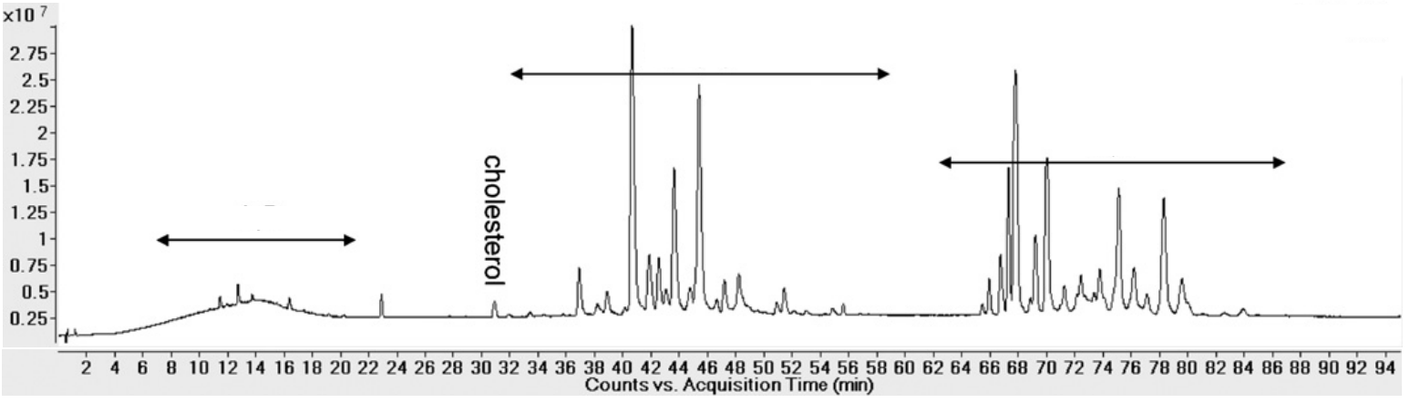
SEPARATION–MS-BASED METABOLOMICS APPROACHES
(Reversed Phase Ultra-High Performance Liquid Chromatography)
RP-(U)HPLC
Scope: Lipids
Mechanism of action in RP-LC of lipids is based on lipophilicity, which is governed by the carbon chain length and the number of double bonds
PC, SM, Cer, DAG
Introduction
CE, TAG
LPC, MAG
Sandra, K. et al., J. Chromatogr. A, 2010, 1217, 4087

Slide 10
SEPARATION–MS-BASED METABOLOMICS APPROACHES
GC
(Gas Chromatography)
Scope: Primary metabolites
Derivatization required
Stability of the extracts max. 2 days
Some compounds undergo degradation
Arginine  ornithine
Creatinine  creatine
Formation of multiple peaks (due to derivatization)
Introduction

Slide 11
SEPARATION–MS-BASED METABOLOMICS APPROACHES
HILIC
(Hydrophilic Interaction Chromatography)
Scope: Very-polar and polar metabolites
Complementary technique to RP-LC and GC (derivatization)
Less prone to thermal degradation of compounds as compared to GC
Longer equilibration time as compared to RP-LC
Introduction

Slide 12
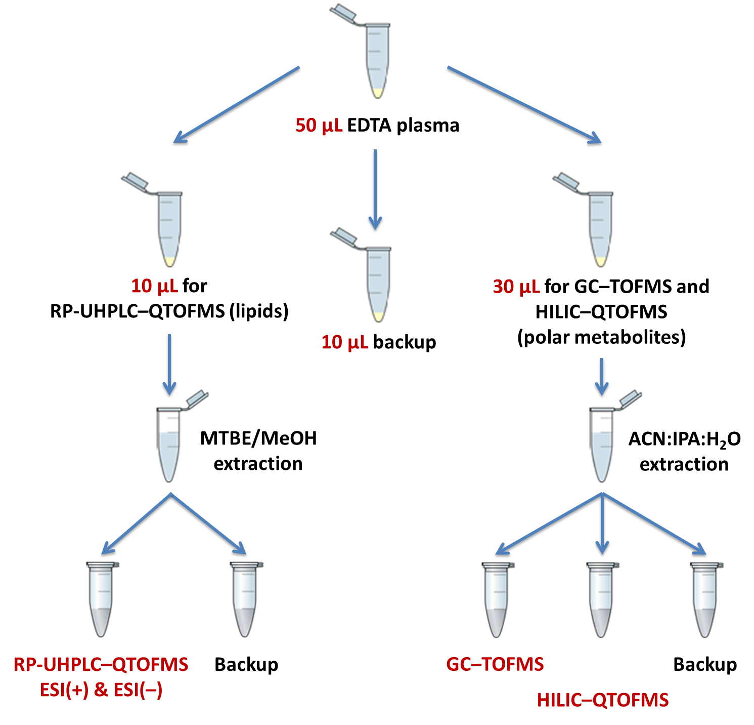
GENERAL SCHEME OF ANALYSES

Slide 13



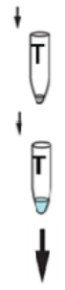

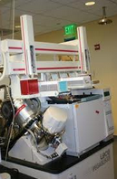
Sample Extraction: SOP PROTOCOL
GC–TOFMS (primary metabolites)
30 µL plasma
+ 1000 µL ice-cold ACN:IPA:H₂O
Re-suspending with 50% ACN 450 µL
Vortexing (10 s)
Shaking (5 min; 4°C)
Centrifugation (2 min; 14,000×g)
Remove supernatant to a new Eppendorf tube
Centrifugation (2 min; 14,000×g)
Drying
Derivatization
10 µL MeOX (40 mg/mL in pyridine)
Shaking (1.5 h; 30°C)
100 µL MSTFA + FAME mixture
Shaking (37°C)
Transfer content to glass vial with micro-insert
GC–EI-TOFMS analysis
Transfer the upper phase to two separate tubes (450 µL/each tube)
Drying: one tube only
(second tube as back-up)

Slide 14
Sample Extraction: P20 PROTOCOL
GC–TOFMS (primary metabolites)
30 µL plasma
+ 1000 µL ice-cold ACN:IPA:H₂O
Re-suspending with 50% ACN 500 µL
Vortexing (10 s)
Shaking (5 min; 4°C)
Centrifugation (2 min; 14,000×g)
Remove supernatant to a new Eppendorf tube
Centrifugation (2 min; 14,000×g)
Drying
Derivatization
10 µL MeOX (40 mg/mL in pyridine)
Shaking (1.5 h; 30°C)
60 µL MSTFA + FAME mixture
Shaking (37°C)
Transfer content to glass vial with micro-insert
GC–EI-TOFMS analysis
Transfer the upper phase to three separate tubes (300 µL/each tube)
Drying: one tube only
(second tube as back-up; third tube for HILIC)

Slide 15
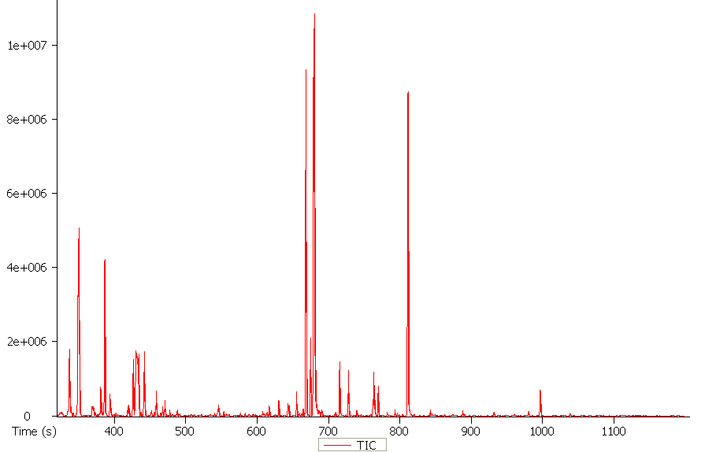
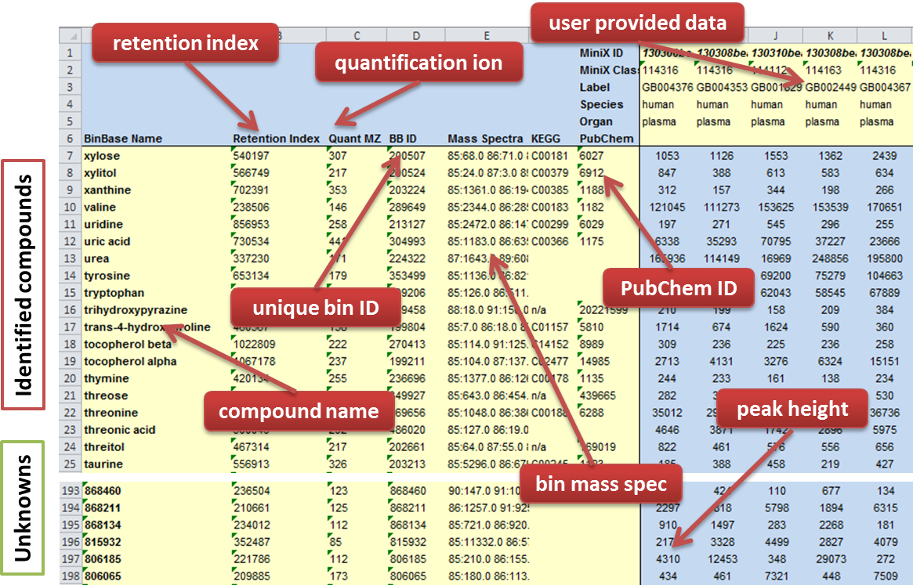
DATA PROCESSING
BinBase
Completely automated analysis tool (database system) for the annotations of GC–EI-TOFMS data
Example of GC–EI-TOFMS profile of human plasma (primary metabolites)

Slide 16
Sample Extraction: SOP PROTOCOL
UHPLC–QTOFMS (LIPIDS)
20 µL plasma
+ 225 µL ice-cold MeOH (containing QC mix)
Vortexing (20 s)
Centrifugation (2 min; 14,000×g)
Vortexing 10 s
Transfer the upper phase to two separate tubes (350 µL/each tube)
Add 750 µL ice-cold MTBE (containing CE(22:1))
Drying: one tube only
(second tube as back-up)
Vortexing (10 s)
Shaking (6 min; 4°C)
Reconstitution: 108.6 µL MeOH:toluene (9:1, v/v) (containing CUDA IS)
Centrifugation (2 min; 14,000×g)
Transfer extracts to two separate glass amber vials with micro-insert
Add distilled water 188 µL
UHPLC–QTOFMS analysis
1.67 µL injection ESI(+) Agilent 6530
5 µL injection ESI(–) Agilent 6550

Slide 17
TRANSFER OF THE METHOD FROM THE AGILENT 6530 TO 6550
x10
8
Plasma equivalent injected: ~331 nL (TEDDY PROTOCOL v. 1)
1.05
1
0.95
0.9
Many saturated ions
0.85
Sample: NIST plasma
Agilent 6550 ESI(+)
0.8
0.75
0.7
0.65
0.6
0.55
0.5
0.45
0.4
0.35
0.3
0.25
0.2
0.15
0.1
0.05
0
1
2
3
4
5
6
7
8
9
10
11
12
Counts vs. Acquisition Time (min)

Slide 18
TRANSFER OF THE METHOD FROM THE AGILENT 6530 TO 6550
Agilent 6530
Agilent 6550
Method SOP
Method A
Method B
Method C
20 µL plasma
↓
225 µL MeOH
+ 750 µL MTBE
+ 188 µL H2O
↓
350 µL aliquot
↓
65 µL resusp.
in MeOH:toluene (9:1, v/v)
↓
3 µL injection
LC–ESI(+)-QTOFMS 6530
Plasma equivalent injected: ~331 nL
(100%)
10 µL plasma
↓
225 µL MeOH
+ 750 µL MTBE
+ 188 µL H2O
↓
350 µL aliquot
↓
130 µL resusp.
in MeOH:toluene (9:1, v/v)
↓
3 µL injection
LC–(ESI+/–)-QTOFMS 6550
Plasma equivalent injected: ~83 nL
(25%)
10 µL plasma
↓
225 µL MeOH
+ 750 µL MTBE
+ 188 µL H2O
↓
200 µL aliquot
↓
150 µL resusp.
in MeOH:toluene (9:1, v/v)
↓
3 µL injection
LC–(ESI+/–)-QTOFMS 6550
Plasma equivalent injected: ~41 nL
(12%)
10 µL plasma
↓
225 µL MeOH
+ 750 µL MTBE
+ 188 µL H2O
↓
100 µL aliquot
↓
200 µL resusp.
in MeOH:toluene (9:1, v/v)
↓
3 µL injection
LC–(ESI+/–)-QTOFMS 6550
Plasma equivalent injected: ~15 nL
(5%)

Slide 19
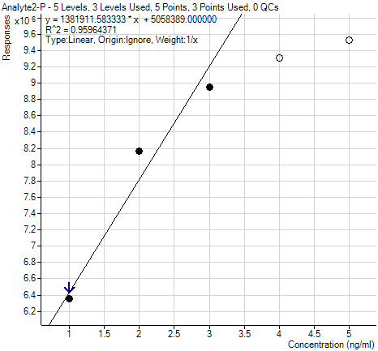
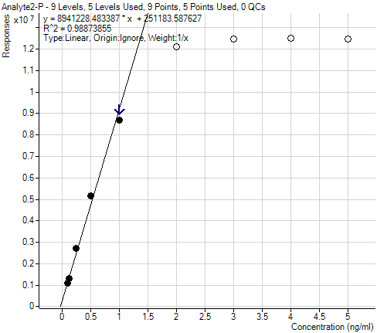
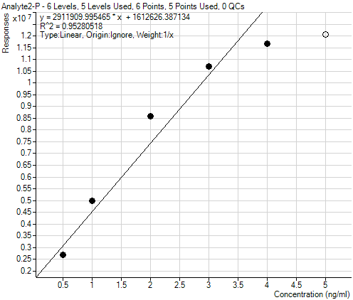
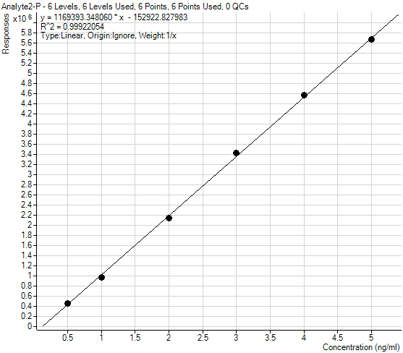
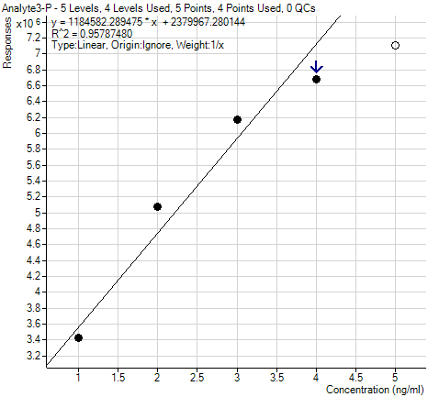
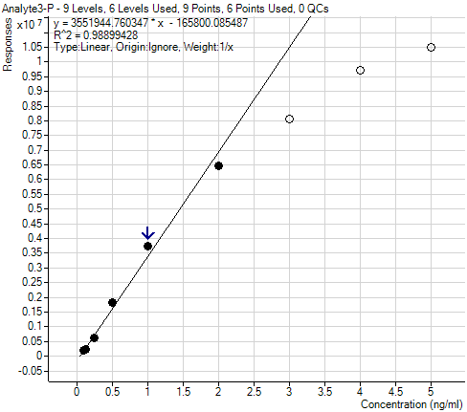
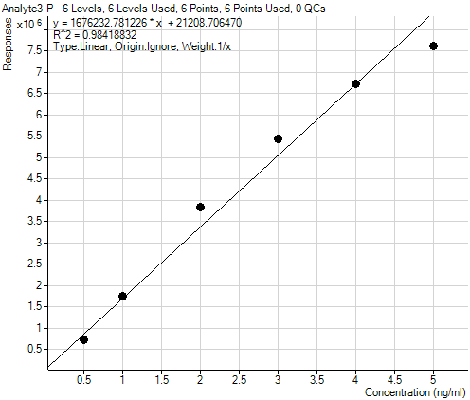
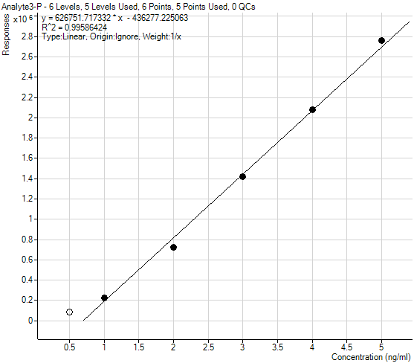
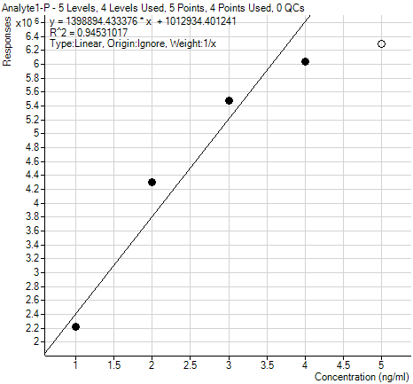
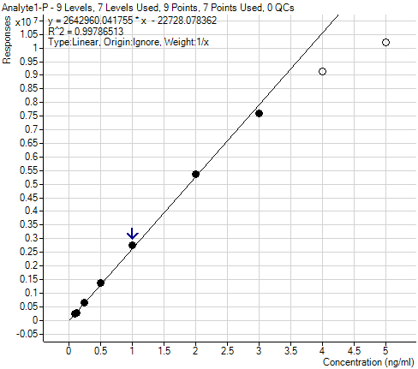
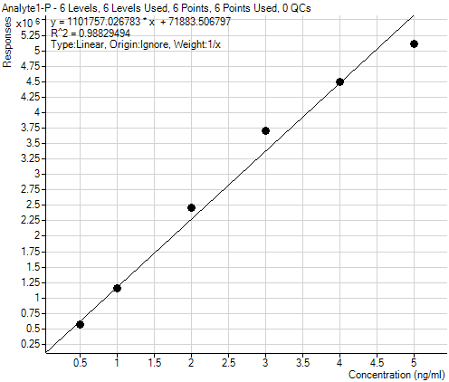
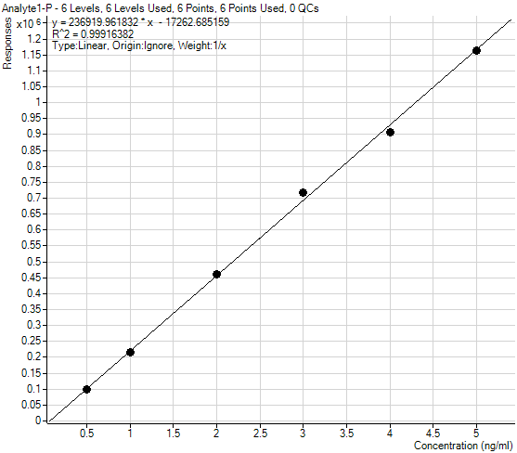
TRANSFER OF THE METHOD FROM THE AGILENT 6530 TO 6550
LINEARITY
Compromise:
Linearity vs. number of features
☑
Method SOP
Method A
Method B
Method C
4 µL
5 µL
2 µL
3 µL
4 µL
5 µL
4 µL
5 µL
5 µL
PC(34:2)
m/z 758.569
3 µL
1 µL
3 µL
4 µL
2 µL
2 µL
3 µL
1 µL; dil. 2x
2 µL
1 µL; dil. 4x
1 µL
1 µL
1 µL
1 µL; dil. 8x
1 µL; dil. 2x
1 µL; dil. 2x
1 µL; dil. 10x
TAG(52:3)
m/z 874.7887
LPC(16:0)
m/z 496.3398

Slide 20
TRANSFER OF THE METHOD FROM THE AGILENT 6530 TO 6550
Plasma equivalent injected: ~41 nL (P20 PROTOCOL)
Plasma equivalent injected: ~110 nL (SOP PROTOCOL v. 2)
x10
8
1.05
Plasma equivalent injected: ~331 nL (SOP PROTOCOL v. 1)
1
0.95
0.9
0.85
Sample: NIST plasma
Agilent 6550 ESI(+)
0.8
0.75
0.7
0.65
0.6
0.55
0.5
0.45
0.4
0.35
0.3
0.25
0.2
0.15
0.1
0.05
0
1
2
3
4
5
6
7
8
9
10
11
12
Counts vs. Acquisition Time (min)

Slide 21
Sample Extraction: P20 PROTOCOL
UHPLC–QTOFMS (LIPIDS)
10 µL plasma
+ 225 µL ice-cold MeOH (containing QC mix)
Vortexing (20 s)
Centrifugation (2 min; 14,000×g)
Vortexing 10 s
Transfer the upper phase to two separate tubes (200 µL/each tube)
Add 750 µL ice-cold MTBE (containing CE(22:1))
Drying: one tube only
(second tube as back-up)
Vortexing (10 s)
Shaking (6 min; 4°C)
Reconstitution: 150 µL MeOH:toluene (9:1, v/v) (containing CUDA IS)
Centrifugation (2 min; 14,000×g)
Transfer extracts to two separate glass amber vials with micro-insert
Add distilled water 188 µL
UHPLC–QTOFMS analysis
3 µL injection ESI(+) Agilent 6550
3 µL injection ESI(–) Agilent 6550

Slide 22
Separation of Lipids:
Ultra-High Performance LC
CSH (Charged Surface Hybrid) Technology
Column: Acquity UPLC CSH C18 (100 × 2.1 mm; 1.7 µm)
Good retention and separation of lipid classes (PC, lysoPC, PE, PS, TG, ceramides)
Peak width: 8–17 s
Excellent repeatability of retention times
Mobile phase A: 60:40 ACN:H₂O + 10 mM AmF + 0.1% FA
Mobile phase B: 90:10 IPA:ACN + 10 mM AmF + 0.1% FA
Temperature: 65°C
Flow-rate: 0.6 mL/min
Sample temperature: 4°C

Slide 23
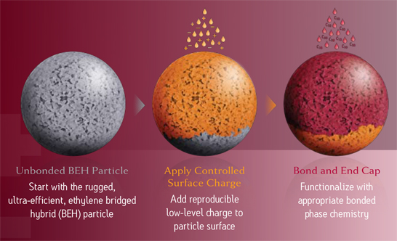
CSH (Charged Surface Hybrid) Technology
Based on Waters Ethylene Bridged Hybrid (BEH) particle technology
CSH particles incorporate a low level surface charge
Designed to improve sample loadability and peak asymmetry in low-ionic-strength mobile phases, while maintaining the mechanical and chemical stability inherent in BEH particle technology
The advantages of CSH Technology include:
Superior peak shape for basic compounds
Increased loading capacity
Rapid column equilibration after changing mobile-phase pH
Improved batch-to-batch reproducibility
Exceptional stability at low and high pH
http://www.waters.com

Slide 24
Separation of Lipids:
Ultra-High Performance LC
LPC, LPE
PC, SM, Cer, DG
CE, TG
Gradient:
0 min 15% (B)
0–2 min 30% (B)
2–2.5 min 48% (B)
2.5–11 min 82% (B)
11–11.5 min 99% (B)
11.5–12 min 99% (B)
12–12.1 min 15% (B)
12.1–15 min 15% (B)
ESI(+)
15 min
run-to-run
cycle
1
2
3
4
5
6
7
8
9
10
11
12
13
14
LPC, LPE
FA
SM, PE, PG, Cer
Gradient:
0 min 15% (B)
0–2 min 30% (B)
2–2.5 min 48% (B)
2.5–9.5 min 76% (B)
9.5–9.6 min 99% (B)
9.6–10.5 min 99% (B)
10.5–10.6 min 15% (B)
10.6–13.5 min 15% (B)
ESI(–)
13.5 min
run-to-run
cycle
1
2
3
4
5
6
7
8
9
10
11
12
13

Slide 25
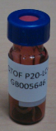

QTOFMS DETECTION
SOP PROTOCOL
Agilent 6530
ESI(+)
Mass resolving power: 10,000 FWHM
20 µL
plasma
Extraction procedure
Agilent 6550
ESI(–)
Mass resolving power: 20,000 FWHM
4 working days / 1 batch ≈400 injections
P20 PROTOCOL
10 µL
plasma
Extraction procedure
Agilent 6550
ESI(+)
Agilent 6550
ESI(–)
8 working days / 1 batch ≈400 injections

Slide 26
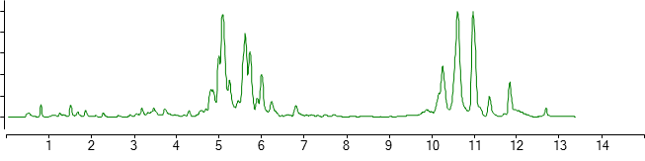
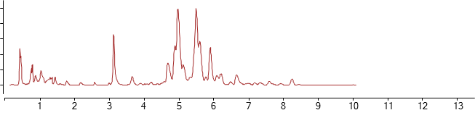
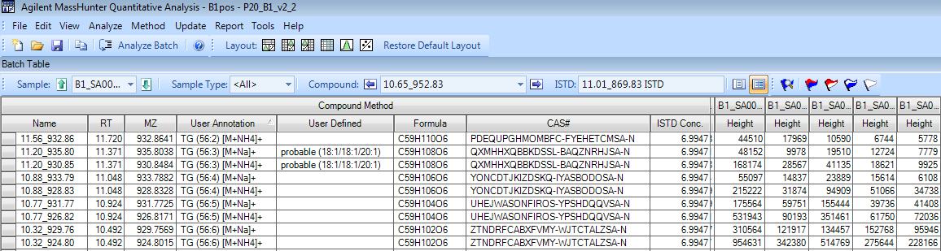
DATA PROCESSING
MassHunter — Quantitative Analysis
Target approach for reporting intensities (or concentrations of analytes)
IS used for RT correction (as well as quantification)
Example of LC–ESI(+/–)-QTOFMS profile of human plasma (lipids)
retention time
elemental composition
quantification ion
conc. of IS
InChIKey
Identified compounds
peak height
RT_MZ ID
Unknowns
compound name

Slide 27
OVERVIEW OF IDENTIFIED LIPIDS
ESI(+)
ESI(–)

Slide 28
QUANTIFICATION OF LIPIDS
A mixture of odd chain and deuterated lipid internal standards
ESI(+)
TIC
ESI(–)
TIC
1
2
3
4
5
6
7
8
9
10
11
12
13
14
1
2
3
4
5
6
7
8
9
10
11
12
13
1
13
2
3
4
5
6
7
8
9
10
11
14
12
1
2
3
4
5
6
7
EIC
(internal standards)
EIC
(internal standards)
1
2
3
4
5
6
7
8
9
10
11
12
13
14
1
2
3
4
5
6
7
8
9
10
11
12
(1) CUDA ^{*)}
(2) Sphingosine (d17:1)
(3) LysoPE(17:1)
(4) LysoPC(17:0)
(5) MG(17:0/0:0/0:0)
(6) DG(18:1/2:0/0:0)
(7) PC(12:0/13:0)
(8) DG(12:0/12:0/0:0)
(9) d₇-Cholesterol
(10) SM(17:0)
(11) C17 Ceramide
(12) PE(17:0/17:0)
(13) d₅-TG(17:0/17:1/17:0)
(14) CE(22:1)
(1) CUDA ^{*)}
(2) LysoPE(17:1)
(3) LysoPC(17:0)
(4) d₃-Palmitic acid
(5) SM(17:0)
(6) PG(17:0/17:0)
(7) PE(17:0/17:0)
^{*)} IS used for quality control (injection)

Slide 29
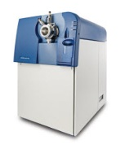
Sample Extraction: P20 PROTOCOL
HILIC–QTOFMS (POLAR METABOLITES)
30 µL plasma
+ 1000 µL ice-cold ACN:IPA:H₂O
Re-suspending with
80% ACN 60 µL
(containing a mixture of internal standards)
Vortexing (10 s)
Shaking (5 min; 4°C)
Centrifugation (10 min; 16,000×g)
Transfer 50 µL to glass vial with micro-insert
HILIC–ESI(+)-QTOFMS analysis
Centrifugation (2 min; 14,000×g)
Transfer the upper phase to three separate tubes (300 µL/each tube)
Drying: one tube only
(second tube for GC–TOFMS; third tube as a backup)

Slide 30
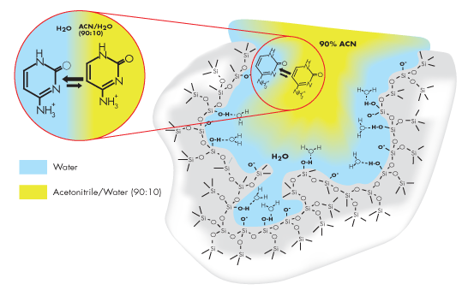
Separation of Polar Compounds:
Hydrophilic Interaction Chromatography (HILIC)
Column: ACQUITY UPLC BEH Amide Column (100 × 2.1 mm; 1.7 µm)
Chemically stable, trifunctionally-bonded amide phase
Good retention and separation of polar metabolites (TMAO, betaine, amino acids)
Peak width: 6–15 s
Mobile phase A: 10 mM AmF + 0.125% FA
Mobile phase B: 10 mM AmF + 0.125% FA 95:5 ACN:H₂O
Temperature: 45°C
Flow-rate: 0.4 mL/min
Sample temperature: 4°C

Slide 31

Separation of Polar Compounds:
HILIC
Gradient
0 min 100% B
0 min → 2 min 100% B
2 min → 7.7 min 70% B
7.7 min → 9.5 min 40% B
9.5 min → 10.25 min 30% B
10.25 min → 12.75 100% B
16.75 min 100% B
TIC
(3)
TripleTOF (AB SCIEX)
Acquisition
(1) Full Mass Spectra (m/z 55–1000)
(2) MRM for selected metabolites (TMAO, betaine)
(2)
(4)
(6)
(1)
(5)
(1) Choline-D₉
(2) TMAO-D₉
(3) Betaine-D₉
(4) L-Carnitine-D₃
(5) Creatine-D₃
(6) L-Arginine-¹⁵N₂
(7) Glutamine-D5
(8) γ-Butyrobetaine (labeled)
(9) trans-Crotonobetaine (labeled)

Slide 32

DISCOVERING PITFALLS
Preparation of QC mix
Saturation of the MCP detector and electrospray
High-fat plasma samples
Normalization strategies
Comparison of ESI(+) and ESI(–) quantitative data for lipids detected in both modes

Slide 33
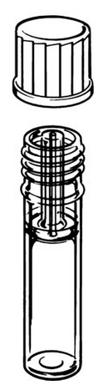
PREPARATION OF QC MIX
Possible pitfalls
Stability of standards
Store all stock solutions at –20°C
Precipitation during storage at –20°C
Allow the stock standards to equilibrate at room temperature (min. 30 min)
Solubility of some standards needs to be enhanced by sonication
Evaporation of solvents from stock solutions
Use of Certan capillary bottle (Kapillarflasche): 4.5 mL or 1.5 mL
Vial with a narrow 0.8 mm hole
Secure storage, minimal evaporation

Slide 34
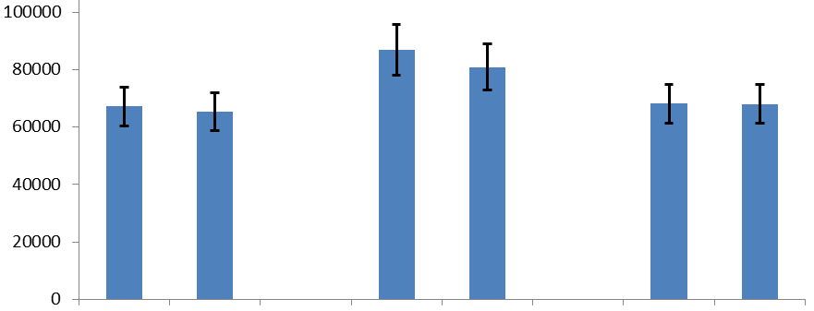
PREPARATION OF QC MIX
Possible pitfalls
Preparation of stock solutions and “QC mix” extraction solvents
Compare the new “QC mix” solution with the old one by LC–MS analysis: the deviation should be <10%
Example: IS-PC(12:0/13:0)
±10%
Peak height
Batch #1 vs. Batch #2
Batch #3 vs. Batch #4
Batch #2 vs. Batch #3

Slide 35
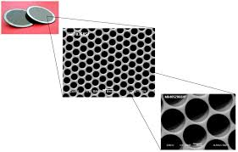
SATURATION OF THE MCP DETECTOR AND ELECTROSPRAY
Saturation of the MCP detector and/or ADC
Multiple ions with the same m/z arrive at the detector at the same time.
Only a part of ions is detected/recorded.
Isotope profile is distorted.
10⁸
Saturation of MCP/ADC
10⁷
Ion intensity
10⁶
Linear range
10⁵
10⁴
0
2
4
6
8
Order of magnitude

Slide 36
SATURATION OF THE MCP DETECTOR
Example: TG(50:2), m/z 848.7
Isotope profile: saturation
Theoretical isotope profile
x10
7
1.1
* 848.7787
Saturated ions
100
848.7702
1.05
90
1
0.95
0.9
80
0.85
* 849.7802
0.8
70
0.75
0.7
60
849.7735
0.65
0.6
Relative Abundance
0.55
50
0.5
0.45
40
0.4
850.7805
0.35
30
0.3
0.25
20
850.7768
0.2
0.15
851.7822
0.1
10
0.05
851.7798
0
849
849.5
850
850.5
851
851.5
852
0
849.0
849.5
850.0
850.5
851.0
851.5
852.0
Counts vs. Mass-to-Charge (m/z)
m/z

Slide 37
SATURATION OF THE MCP DETECTOR
Theoretical isotope profile
[M+NH₄]⁺
Theoretical isotope profile
[M+NH₄]⁺ 100%
[M+1+NH₄]⁺ 59.1%
[M+2+NH₄]⁺ 18.4%
Correction factor:
100/18.4 = 5.43
–43%
x10
7
1.1
[M+1+NH₄]⁺
Isotope profile: saturation
1.05
1
–30%
0.95
0.9
0.85
0.8
0.75
0.7
0.65
0.6
0.55
0.5
☑
0.45
0.4
[M+2+NH₄]⁺
0.35
0.3
0.25
☑
0.2
0.15
[M+3+NH₄]⁺
0.1
0.05
0
849
849.5
850
850.5
851
Counts vs. Mass-to-Charge (m/z)

Slide 38
SATURATION OF THE MCP DETECTOR
Saturation observed for 7 PCs and 7 TGs
The “true” intensity is obtained by multiplying the intensity of [M+2+H]⁺ or [M+2+NH₄]⁺ ion by an appropriate correction factor

Slide 39
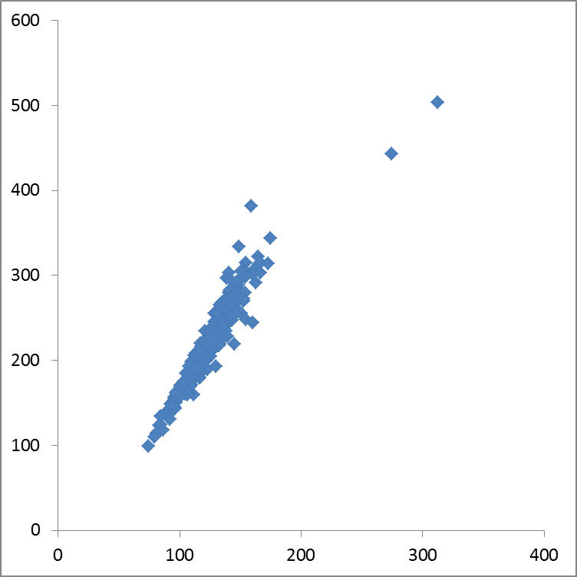
SATURATION OF THE MCP DETECTOR
Example: PC(34:2)
ESI(+)
(Corrected) Concentration (µM)
Calculated using [M+2+H]⁺ intensity
and correction factor
Range: 99–504 µM
Comments:
In batch #1 (n = 300) the concentrations obtained in ESI(+) were around 43% lower as compared to values obtained after correction
Range: 74–312 µM
ESI(+)
(Uncorrected) Concentration (µM)
Calculated using [M+H]⁺ intensity

Slide 40

SATURATION OF THE MCP DETECTOR AND ELECTROSPRAY
Saturation of electrospray
Related to formation of droplets during the ionization process
↑ flow rate ↓ linearity
Analyte 1: ESI saturation
10⁸
Saturation of ESI
10⁸
Saturation of ESI
Analyte 1
Analyte 2
No saturation, no suppression
10⁷
10⁷
Ion intensity
Ion intensity
10⁶
10⁶
Linear range
Linear range
10⁵
10⁵
Analyte 2: Suppression
10⁴
10⁴
0
2
4
6
8
0
2
4
6
8
Order of magnitude
Order of magnitude

Slide 41
SATURATION OF ELECTROSPRAY
Example: High-fat plasma sample
x10
7
7
TIC
6
5
4
3
2
1
0
x10
5
Reference ion
m/z 922.009
1.4
1.2
Real signal intensity
1
Ideal signal intensity (no ESI saturation)
0.8
0.6
0.4
0.2
1
2
3
4
5
6
7
8
9
10
11
12
13
Counts vs. Acquisition Time (min)
ESI saturation regions
Notes:
B1_SA0216

Slide 42
SATURATION OF ELECTROSPRAY
Solution: re-analysis of samples after dilution
Question #1: What should be a criterion for selection of sample for dilution and re-analysis? Difficult to answer…
Question #2: Do we need “more” accurate results for those few most abundant lipids? As PCA shows, the problem is related mainly to “outliers”, that tend to be even more remote
A (NS)
A (S)
B (NS)
C (NS)
B (S)
C (S)
Injection: 3 µL (with suppression)
Injection: 1 µL (without suppression)
Notes:
B1_SA0216

Slide 43
NORMALIZATION STRATEGIES
How can we ensure metabolite data integrity and quantitative robustness in large-scale metabolomics studies?
Multiple internal standards
QC
QC
blank
blank
NIST
samples
samples
normalize to
normalize to
Randomization, block design
Blank and machine quality controls
Reference (QC) and reference standard sample (NIST blood)
Use of multiple internal standards (if applicable)

Slide 44
NORMALIZATION STRATEGIES
Constant row sum using mTIC or TIC
CRS = each variable is divided by the sum of all variables for each sample
mTIC = intensity of all identified metabolites (=knowns)
TIC = intensity of all metabolites (=knowns + unknowns)
Single point quantification using internal standard
Expressed in concentration units (µM)
For uknowns the concentrations are calculated using the nearest internal standards
Batch normalization
Using QC samples in all batches and correction factors

Slide 45
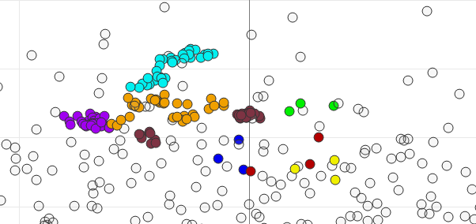
NORMALIZATION STRATEGIES
Data set: ESI(+)
Samples + QC + NIST
Knowns (n = 154)
Data transformation:
CRS (mTIC)
log
Pareto
PCA
Score plot

Slide 46
NORMALIZATION STRATEGIES
PCA
Loading plot
Data set: ESI(+)
Samples only
Knowns (n = 154)
Data transformation:
CRS (mTIC)
log
Pareto
PC (with saturated FA)
TG (with saturated FA)
Ceramides
LPC
SM
CE
DG
PC (with unsaturated FA)
PCA
Score plot
TG (with unsaturated FA)

Slide 47
NORMALIZATION STRATEGIES
Constant row sum using mTIC or TIC
CRS = each variable is divided by the sum of all variables for each sample
mTIC = intensity of all identified metabolites (=knowns)
TIC = intensity of all metabolites (=knowns + unknowns)
Single point quantification using internal standard
Expressed in concentration units (µM)
For uknowns the concentrations are calculated using the nearest internal standards
Batch normalization
Using QC samples in all batches and correction factors

Slide 48
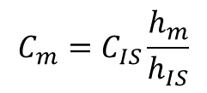
NORMALIZATION STRATEGIES
Single point quantification using internal standard
Batch normalization
Calculation of median C_{m} or median ratio (h_{m}/h_{IS}) for each metabolite in each batch of QC
Calculation of correction factor (from QC samples)
F_{m;2,1} = med(batch 2) / med(batch 1)
F_{m;3,1} = med(batch 3) / med(batch 1)
F_{m;4,1} = med(batch 4) / med(batch 1)
Application of correction factors to batches 2–4 (to all samples and QC/NIST samples)
C_{m, batch 2, corr} = C_{m, batch 2, uncorr} / F_{m;2,1}
C_{m, batch 3, corr} = C_{m, batch 3, uncorr} / F_{m;3,1}
C_{m, batch 4, corr} = C_{m, batch 4, uncorr} / F_{m;4,1}
$$C_{m}=C_{IS}\frac{h_{m}}{h_{IS}}$$

Slide 49
NORMALIZATION STRATEGIES
Data set: ESI(+)
Samples + QC + NIST
Knowns (n = 154)
Data transformation:
IS correction
log
Pareto
PCA
Score plot

Slide 50
NORMALIZATION STRATEGIES
Data set: ESI(+)
Samples + QC + NIST
Knowns (n = 154)
Data transformation:
IS correction
batch normalization
log
Pareto
PCA
Score plot

Slide 51
NORMALIZATION STRATEGIES
CE
PCA
Loading plot
SM
LPC
PC
Data set: ESI(+)
Samples only
Knowns (n = 154)
Data transformation:
IS correction
batch normalization
log
Pareto
Ceramides
TG (with saturated FA)
PCA
Score plot
DG
TG (with unsaturated FA)

Slide 52
NORMALIZATION STRATEGIES
Data set: ESI(–)
Samples + QC + NIST
Knowns (n = 152)
Data transformation:
IS correction
log
Pareto
PCA
Score plot

Slide 53
NORMALIZATION STRATEGIES
Data set: ESI(–)
Samples + QC + NIST
Knowns (n = 152)
Data transformation:
IS correction
batch normalization
log
Pareto
PCA
Score plot

Slide 54
NORMALIZATION STRATEGIES
PCA
Loading plot
Data set: ESI(–)
Samples only
Knowns (n = 152)
Data transformation:
IS correction
batch normalization
log
Pareto
Free FA
PS
PE
PC
SM
Ceramides
LPC
PCA
Score plot
Plasmenyl-PC
Plasmenyl-PE

Slide 55
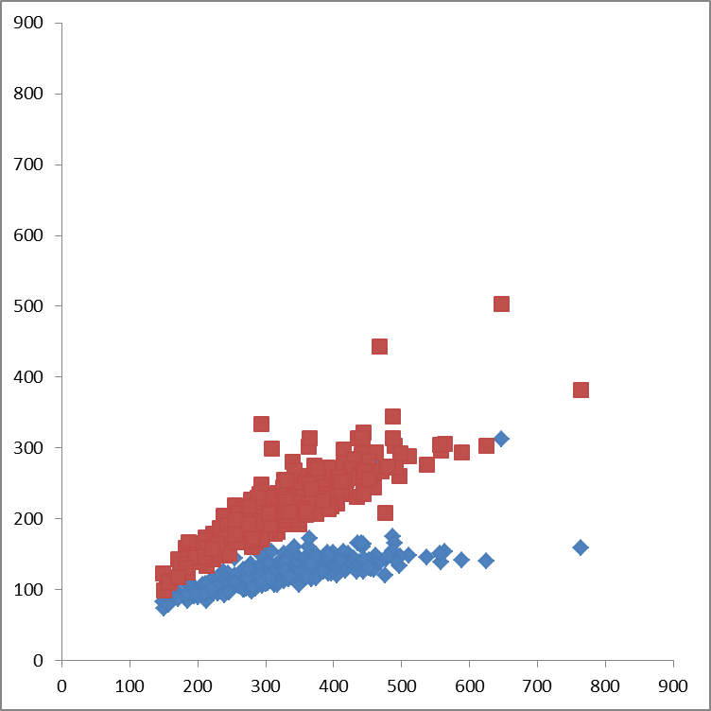
COMPARISON OF QUANTITATIVE RESULTS: ESI(+) and ESI(–)
Example #1: High abundant PC(34:2)
ESI(+)
(Corrected) Concentration (µM)
Calculated using [M+2+H]⁺ intensity
and correction factor
Range: 99–504 µM
ESI(+)
(Uncorrected) Concentration (µM)
Calculated using [M+H]⁺ intensity
Range: 74–312 µM
Comments:
In batch #1 (n = 300) the corrected concentrations obtained in ESI(+) were around 34% lower as compared to ESI(–)
For comparison, 62% lower if concentrations were not corrected in ESI(+)
Possible explanation is ion suppression during ESI(+)
ESI(–)
Concentration (µM)
Range: 149–764 µM

Slide 56
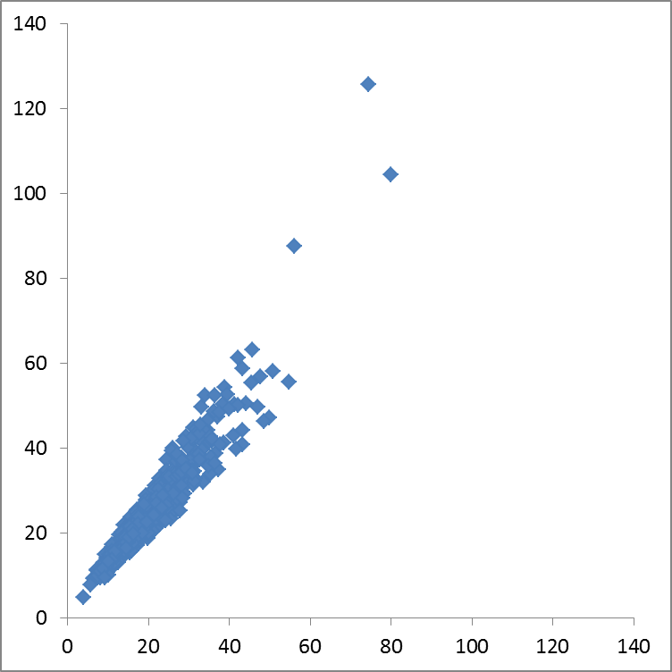
COMPARISON OF QUANTITATIVE RESULTS: ESI(+) and ESI(–)
Example #2: Low abundant PC(36:1)
Range: 4.8–126 µM
Comments:
In batch #1 (n = 300) the concentrations obtained in ESI(+) were around 18% lower as compared to ESI(–)
Possible explanation is ion suppression during ESI(+)
ESI(–)
Concentration (µM)
Range: 3.9–80 µM
ESI(+)
Concentration (µM)

Slide 57
QUALITY CONTROL:
TUNING OF THE INSTRUMENT
7
■ Sample run after Standard tune #1
■ Sample run after Initial tune + Standard tune #2
Standard Tune #1
x10
3.0M
5
4.5
4
3.5
3
Initial Tune +
Standard Tune #2
2.5
2
9.0M
1.5
1
0.5
0
1
2
3
4
5
6
7
8
9
10
11
12
Counts vs. Acquisition Time (min)
(1) Check always the ion intensity of calibration solution
(2) Lower ion intensity of calibration solution indicates decrease of signal intensity
(3) Recommendations: Clean the ion source, conduct initial tune (>1 h), follow standard tune (20 min)

Slide 58
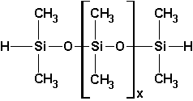
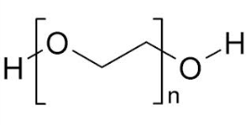
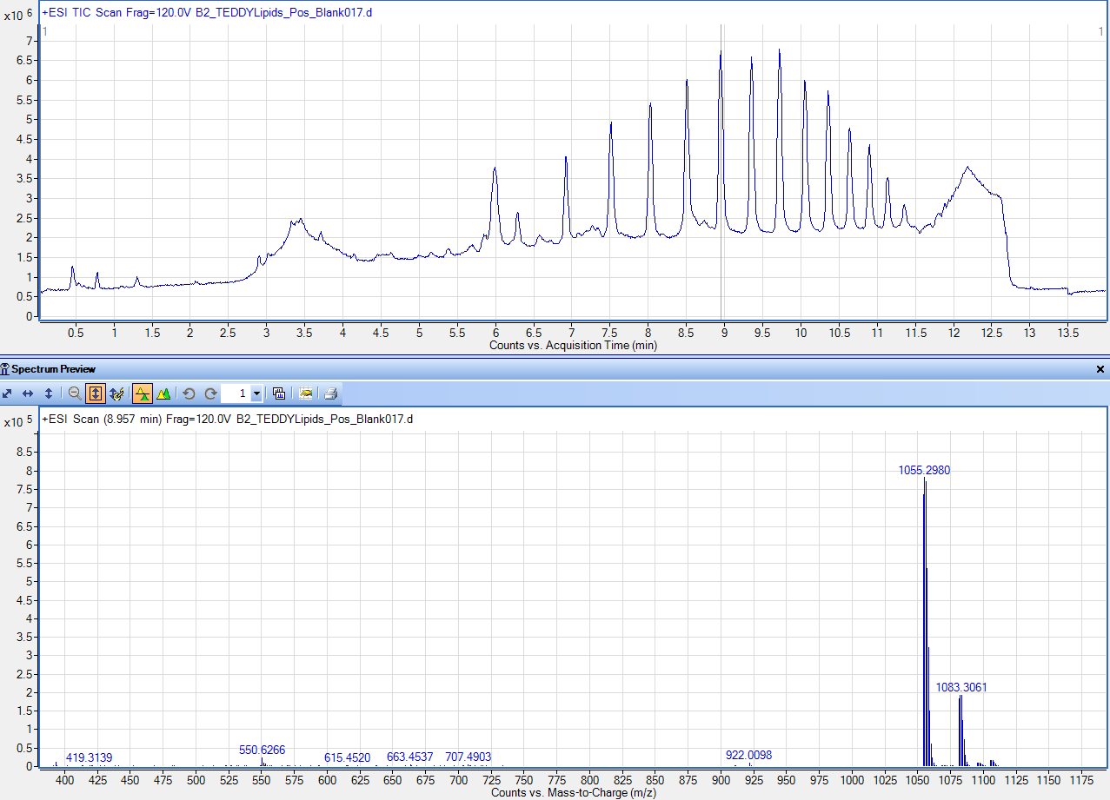
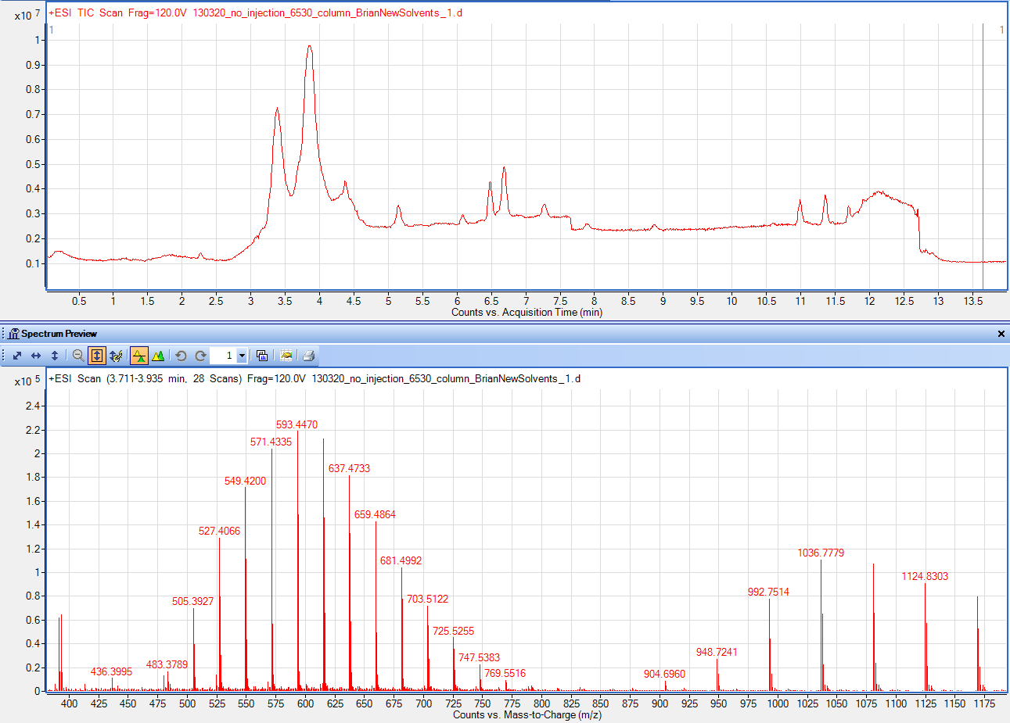
QUALITY CONTROL:
Common Contaminants in LC–MS
Polysiloxanes
Source: septa
PEG
Source: solvents, tubing
+74 series
+22 and +44 series

Slide 59
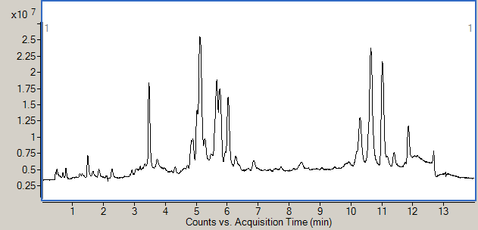
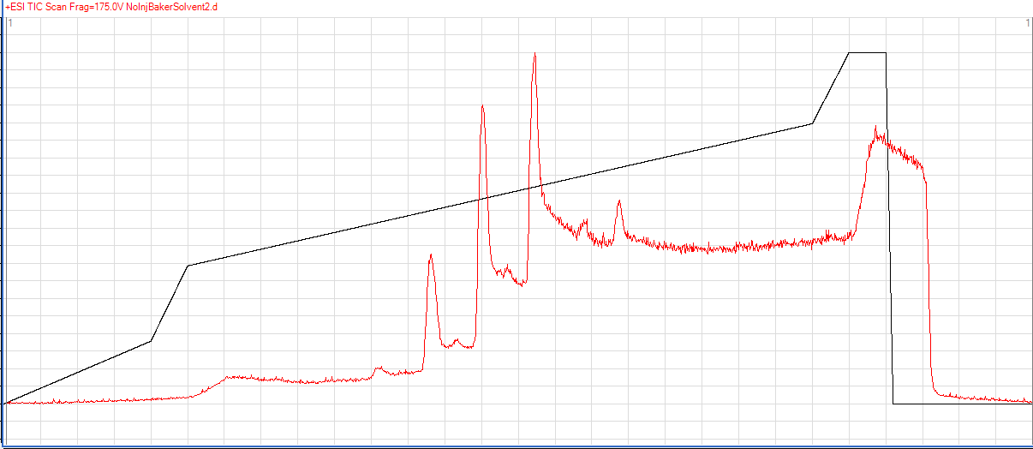
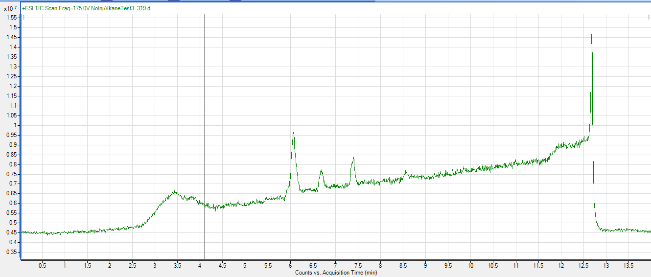
QUALITY CONTROL:
Common Contaminants in LC–MS
Phthalates
Source: plastics
Alkanes
Source: solvent
Di-n-octyl phthalate
m/z 391.3 [M+H]⁺
m/z 413.3 [M+Na]⁺
“No injection” TIC profile with contaminated
solvent (IPA) used
(1) Check always the background noise for 100% mobile phase A and 100% mobile phase B prior the sequence.
(2) Check always the quality of the solvents when changing manufacturer and/or lot.
(3) Note that “LC–MS grade” does not mean “totally free” of ALL contaminants.
“No injection” TIC profile with “pure” solvents used

Slide 60
PUBLICATIONS
Analysis of Complex Lipid Mixtures in Biological Systems Using Liquid Chromatography–Mass Spectrometry
• Review paper (TrAC-Trends in Analytical Chemistry)
Advantages and Limitations of (Ultra-)High Resolution Mass Spectrometry in the Analysis of Complex Lipids in Human Plasma
• Comparison of Citius, Agilent 6550
Discovering Pitfalls in Large-Scale Metabolomic Study of Human Plasma
• Based on the analysis of ca. 1160 samples (P20)
Pathway Phenotyping Study
• Single-blinded, placebo-controlled, postprandial, crossover in triplicate study designed to determine the effects of a high gamma-linolenic acid fat (GF) challenge compared with a high-monounsaturated fatty acid control fat (CF) challenge on plasma fatty acid composition
• n = 210 samples (7 participants; 2 dietary challenges (GF, CF); 3 different days (30 day wash-out period); blood samples at 0–2–4–6–8 hr); 7 x 2 x 3 x 5 = 210
• Lipids Analysis using UHPLC–QTOFMS in ESI(+) and ESI(–) (Agilent 6550)
Standardization in LC–MS-based Metabolomics
• Comparison of instrumental platforms (accent to quantitative aspect/normalization in metabolomics)
• n = 126 samples (out of 210 samples from the Pathway phenotyping study) (7 participants; 2 dietary challenges (GF, CF); 3 different days (30 day wash-out period); blood samples at 0–2–4 hr); 7 x 2 x 3 x 3 = 126
• Analysis in ESI(+) only
• Lipids (CSH) and polar compounds (HILIC)
• Instrumental platforms: Agilent 6550, TripleTOF, Citius, Q-Exactive

Slide 61
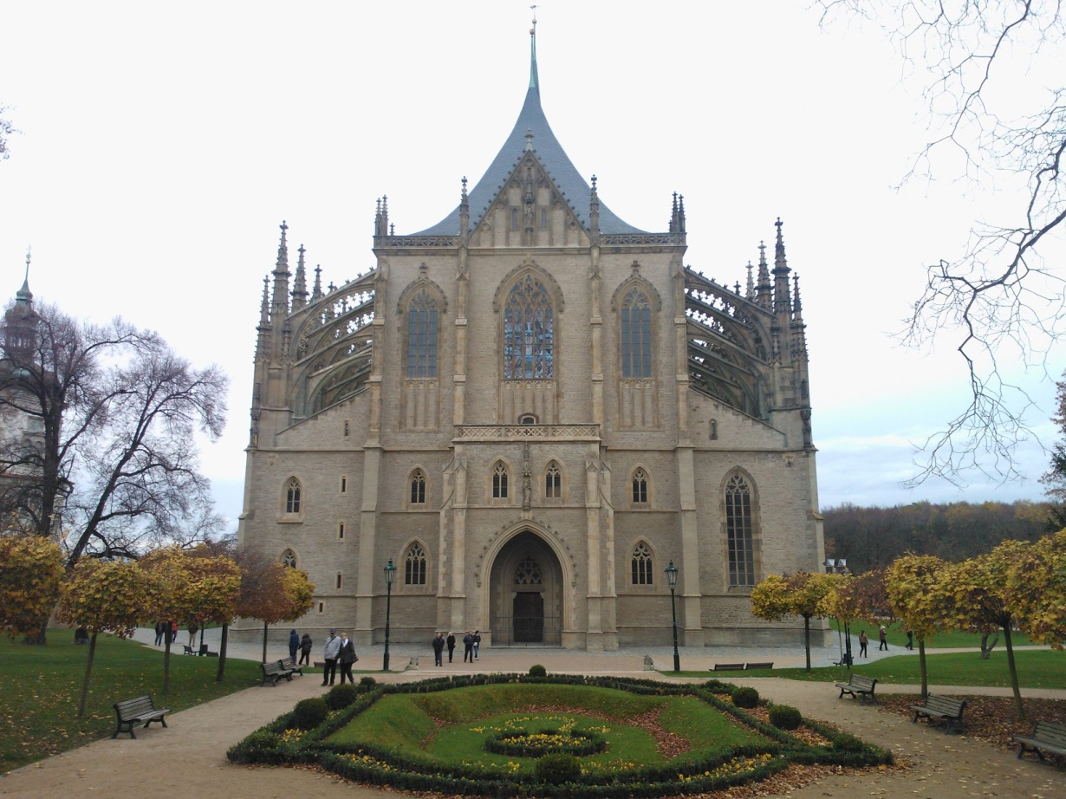
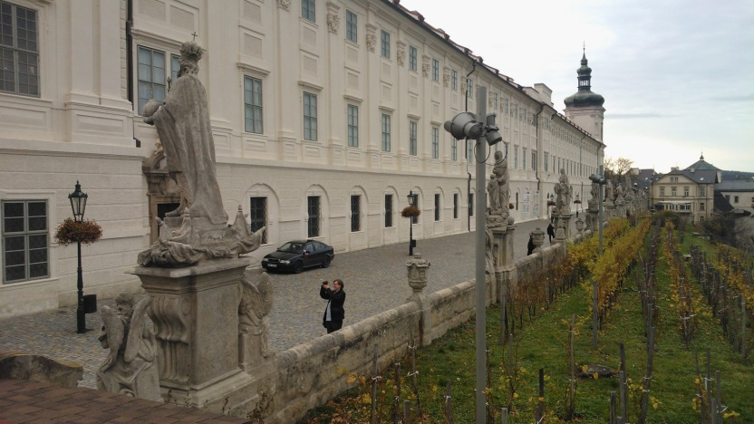
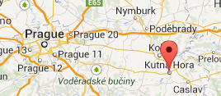
St. Barbara's Church, Kutná Hora
Acknowledgements
Brian DeFelice
Carlos Leon
Alex Chassy
William Wikoff
Thank you for your attention…
tcajka@ucdavis.edu

